Slide 1
Programming 101 Day 4
Basic Data Structures

Slide 2
Outline
String
Errors

Slide 3
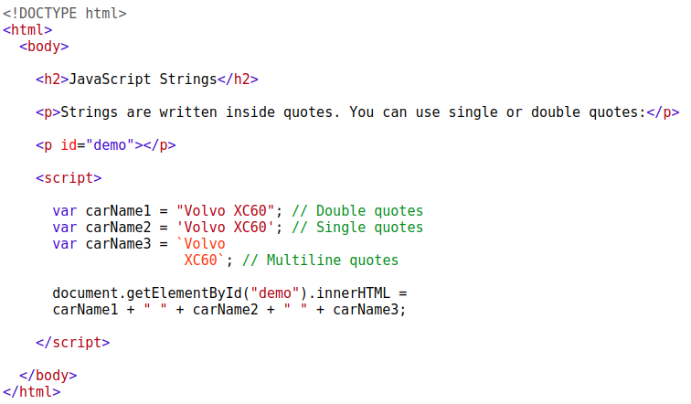
String

Slide 4

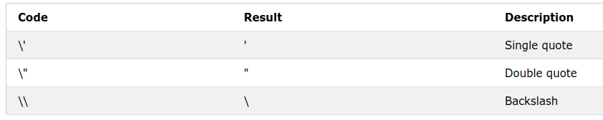
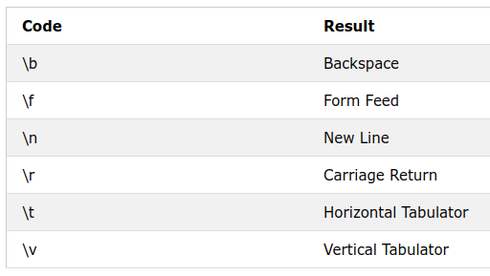
String

Slide 5


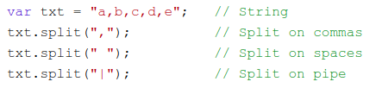
String

Slide 6
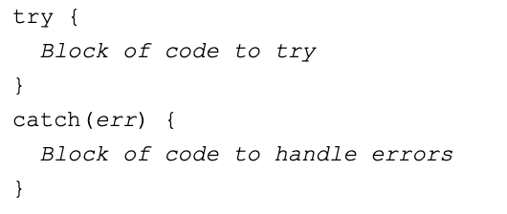
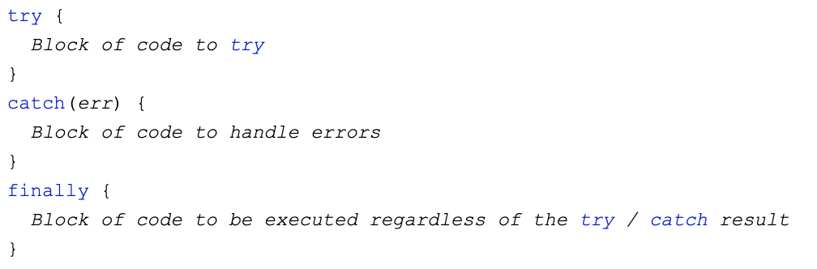
Errors

Slide 7
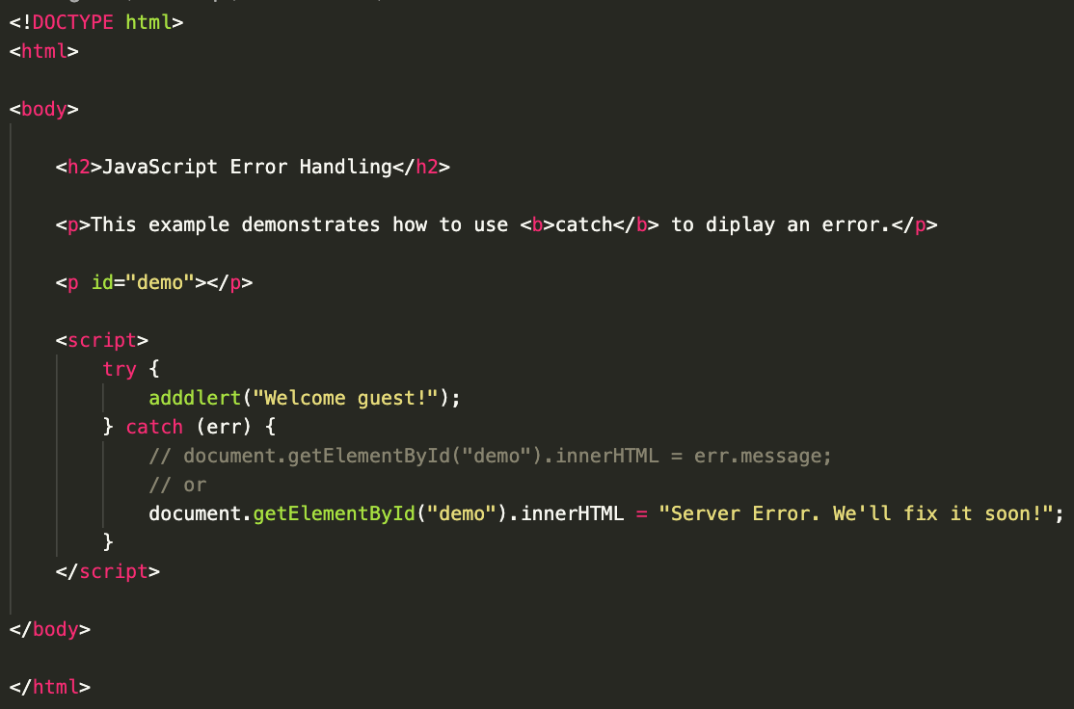
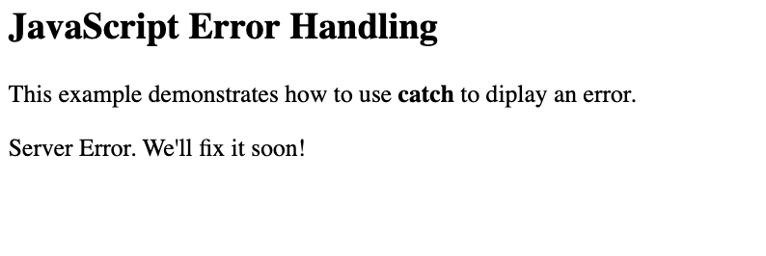
Errors

Slide 8
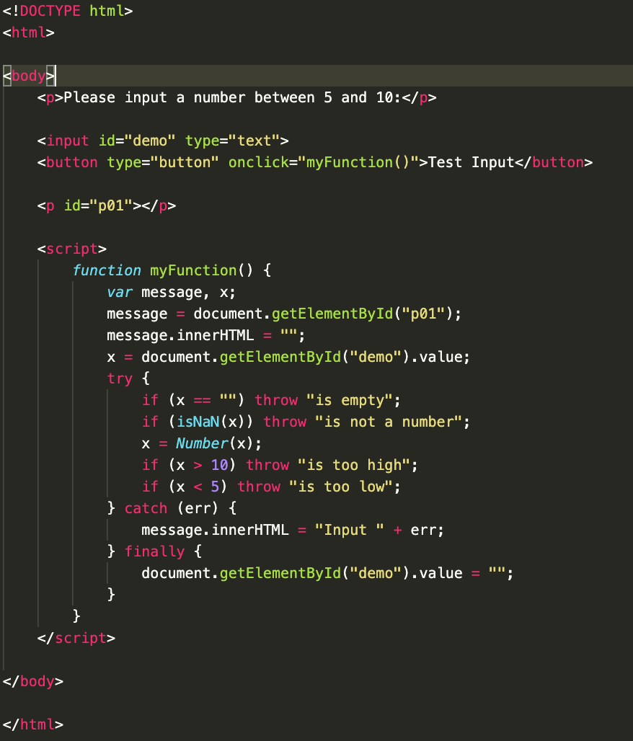
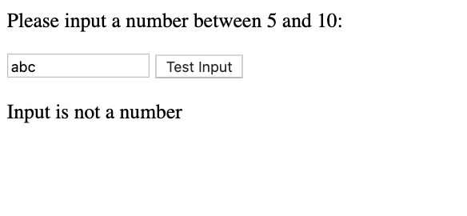
Errors

Slide 9
Keep practicing!
Create html list of person in this room, show their profile and count the number of the people
References:
w3schools.com

Slide 10
“Nothing will work unless you do”
- Maya Angelou

